Slide 1

COOPERATION WITH CHINA & ARAB COUNTRIES IN OIL & GAS INDUSTRY
SONATRACH
Sixth session of the Arab-China Cooperation Conference on Energy
Cairo, November 05th-08th, 2018

Slide 2
Algeria Overview
SONATRACH Overview
SONATRACH - Arab countries Companies Cooperation
SONATRACH – China Companies Cooperation
Conclusion

Slide 3
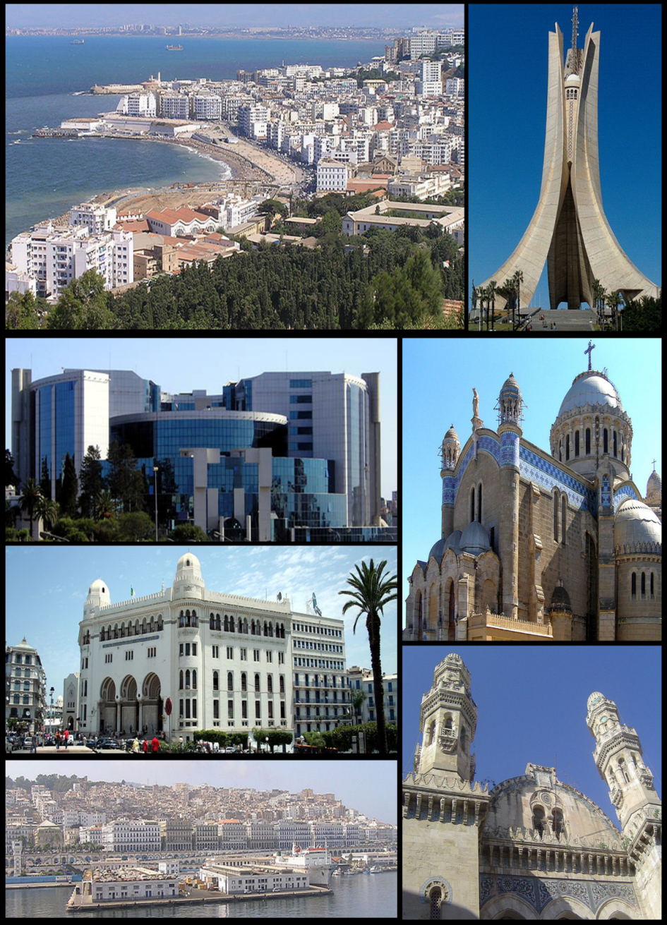
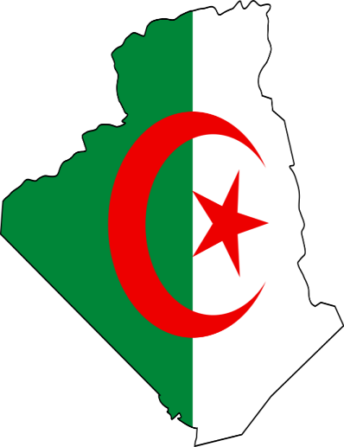
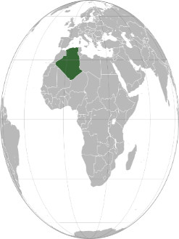
Algeria Overview
People's Democratic Republic of Algeria in 2017
Area : 2,4 million km², world’s 10th, Africa’s 1st
Population : 41,3 million
GDP 2017 : $170 billion (current), 1,6% AGR
GDP per capita : $4,125
Hydrocarbons GDP : 19% of total

Slide 4
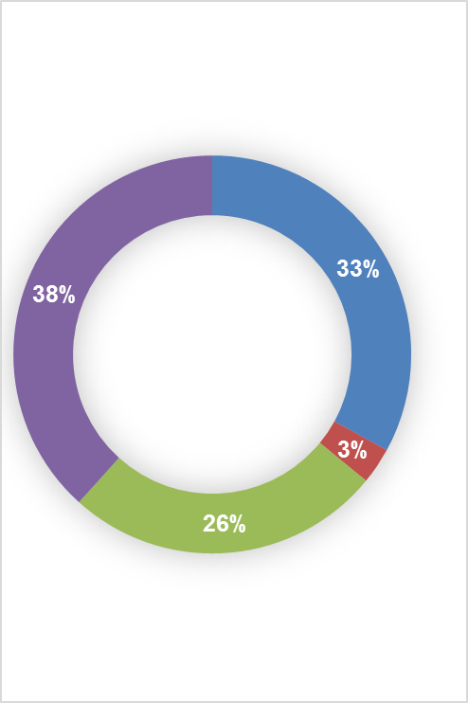

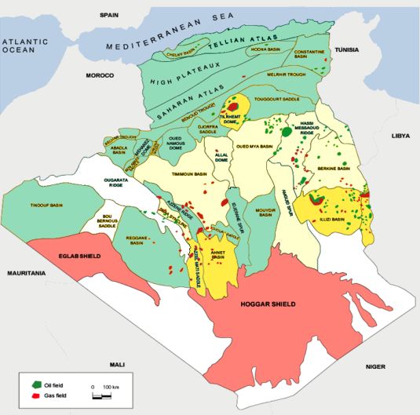
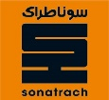

National Mining Domain, Vast … and still Under Explored
ACREAGE
ACTIVE PERIMITERS
EXPLORATION OBJECTIVES
Free Unexplored Acreage
Offshore
Domaine Tellien
Atlas et hauts Plateaux
Sonatrach Exploration Contracts
Hasssi R’Mel
12 Prospect authorizations
78 Perimiter Exploration Phase
171 Perimiter Exploitation Phase
12
Bechar
Oued Mya
Hasssi Messaoud
Berkine
1
1 553 488 km²
(6% Offshore)
Tindouf
Illizi
2
69
9
3
Mouydir
122
49
Chenachène
Tamesna
Partnership Exploration Contracts
Tafassasset
Prospection
Mature Basins
Underexplored zones
Offshore & North Region
Source: ALNAFT, octobre 2017
4

Slide 5

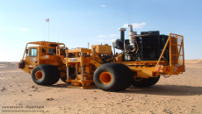
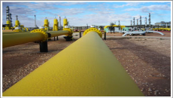
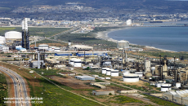
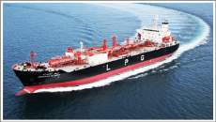











SONATRACH, An integrated Oil & Gas company over the whole value chain
Exploration & Production
Pipeline Transportation
Downstream
Marketing
SONATRACH
44,000
SONATRACH Group
150,000
… with a large portfolio of +100 domestic and international companies
Domestic Companies
32 subsidiary and 19 shareholding
International Companies
29 subsidiary and 26 shareholding
Drilling (ENTP & ENAFOR)
Well Services (ENSP)
Geophysics (ENAGEO)
Construction (ENGTP, ENGCB, …)
Distribution (NAFTAL)
Shipping (HYPROC)
Electricity and Seawater Desalination (AEC)
Fertilizers (ASMIDAL, AOA, Fertial, OCI,.)
Upstream
Transportation
Downstream
Marketing
Shipping

Slide 6
SONATRACH, with International Presence
Spain
Reganosa (10%): Regasification
GEPSA(30%) : Cogeneration
CGC (30%) : Trading
SGC (100%) : Trading
Propanchem (49%): Petrochimicals
UK & Netherlands
Crude Oil Trading, LPG, LNG Regasification
Italy
Oil Refinery, Augusta
France
LNG Trading
Portugal
2% of EDP
25% in EDP Power Plants
Tunisia
03 Exploration blocks
Mauritania
2 Exploration blocks
Peru
Pipeline Project
Gas and Oil Transport from
Camisea Field to
Lima & Callao
The development of
blocks 88 and 56 in Camisea
Libya
2 Exploration blocks
Ghadames Basin
Mali
1 Exploration block
Nigeria
TSGP Gas Pipeline
Niger
1 Exploration Block

Slide 7
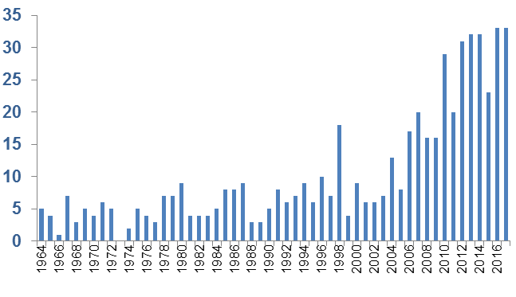
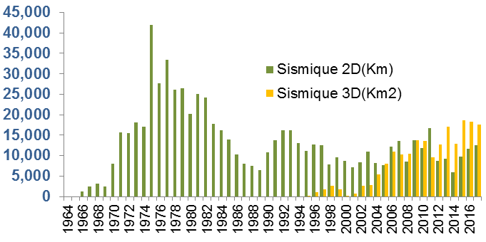
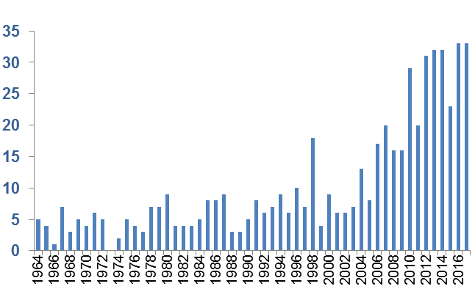
SONATRACH, An intensive Exploration efforts
Exploration Efforts
Exploration Results
2D Seismic
698 649 km²
3D Seismic
192 997 km²
Number of wells drilled
2 759 wells
Number of discoveries
456 discoveries
Volume of discoveries
5 085 Millions TOE

Slide 8
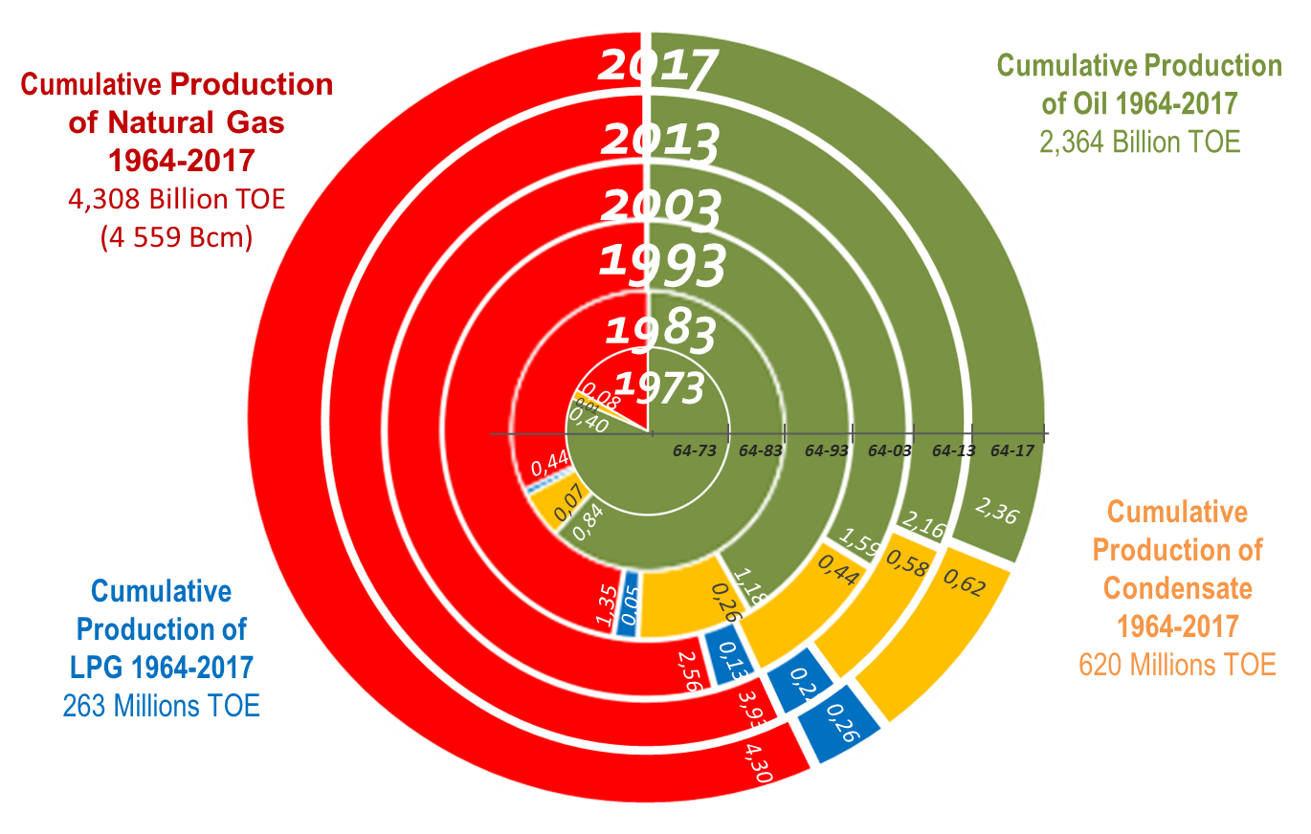
SONATRACH, a Historical Hydrocarbons Producer
Cumulative Production from 1964 to 2017 of 7 555 Million TOE

Slide 9
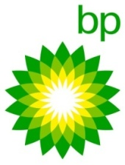
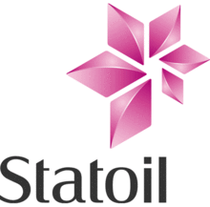
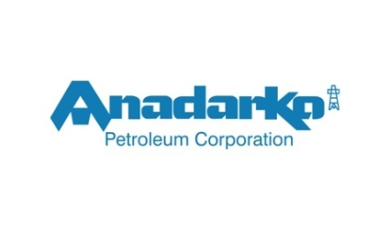
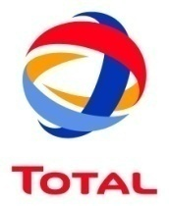
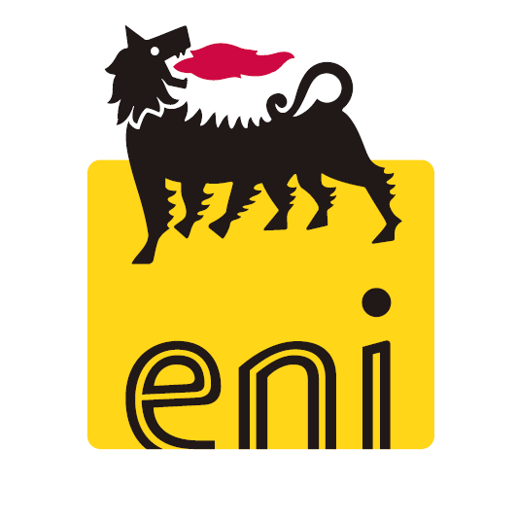
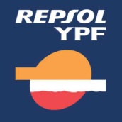
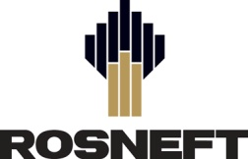
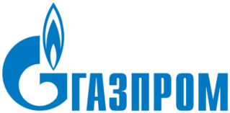

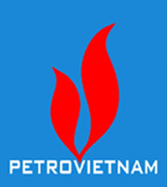
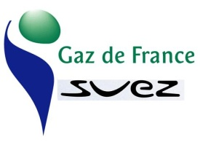

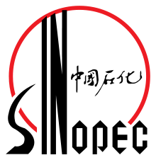
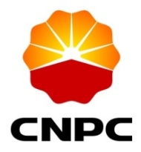
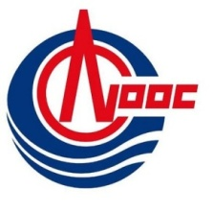
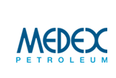
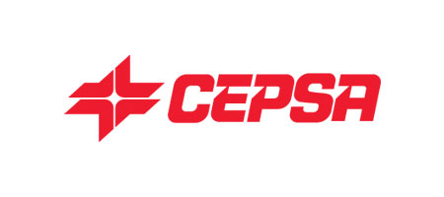


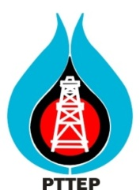
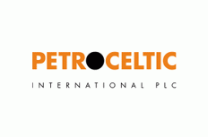
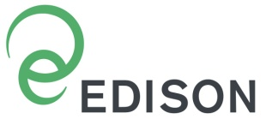
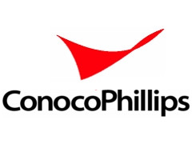


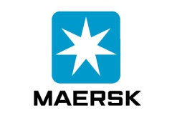

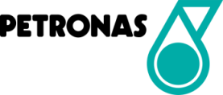
SONATRACH, Rich Successful Partnership in E&P
China
Arab Countries

Slide 10
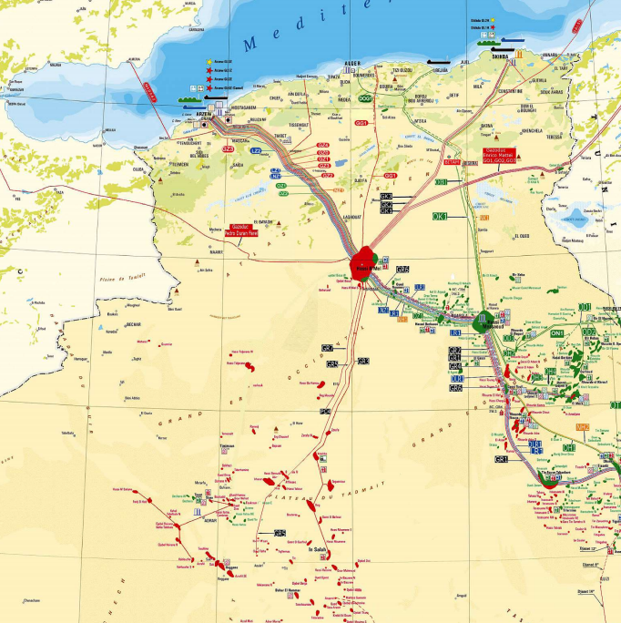
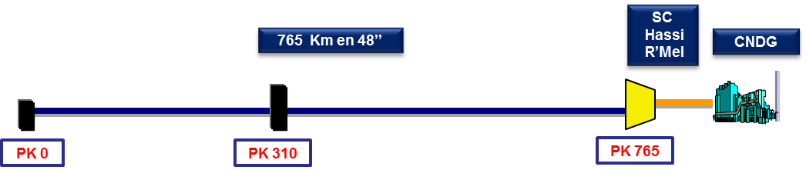
SONATRACH, an Extensive Pipeline Network
Pipelines Network Map
Extensive pipeline network
Gaz, Oil, Condensates and LPG
37 Pipelines over 22 systems
19 623 km
82 pumping stations,
353 machines
3,21 million tons storage
364 Million toe transport capacity
2 Main Hubs
Gas hub at Hassi R’Mel
Oil hub at Hassi Messaoud
3 international gaz export pipelines with 53 bcm total capacity
MEDGAZ to Spain
GPDF to Spain via Morocco
GEM to Italy via Tunisia
Oil hub
Hassi Messaoud
Hassi R’mel
Gaz hub
CDHL
CNDG
CDHL: Dispatching Center for Liquid Hydrocarbons.
CNDG: National Gas Dispatching Center
10

Slide 11
SONATRACH, Important Downstream Assets
Liquefaction of Natural Gas, LPG Separation, Refining and Petrochemicals
LNG
56 mcm/y
Existing
Refining
30 MT * … +5 MT
Existing … & New
LPG Separation
13 MT
Existing
Projects
Projects
Petrochemicals
Existing …&New
SH own effort partnership
Ethylene
Skikda
120 kT
1978
Methanol
Arzew
124 kT
1976/78
HDPE
Skikda
130 kT
2005
AOA
Arzew
Ammoniac 1,3 MT
Urée 2,3 MT
SORFERT
Arzew
Ammoniac 1,5 MT
Urée 1,1 MT
PDH/PP
Arzew
500 kt/y
Polypropylene
Ethane/LPG Cracker
Arzew
1 Mt/y
Ethylene
Methanol
Arzew
1 Mt/y
Methanol
PTA/PET
Skikda
375 kt/y
Polyesters
Tires
5 m/y
MTBE
Arzew
200 kt/y
LAB
Skikda
100 kt/y
Ethane/Naphtha
Vapo-cracking
Skikda
153 KT/y
Ethylene.
GL1Z
17,56 MM³ GNL
1977
GL2Z
17,82 MM³ GNL
1981
GL3Z
4,7 MT GNL
2013
GL2K
4,5 MT GNL
2012
RA1K
16,5 MT
1980
RA2K (NGL)
5 MT
2009
RA1G
3,6 MT
1964
RA1Z
3,8 MT
1973
RHM2
(Hassi Messaoud)
1,1 MT
RA1D
Adrar
0,6 MT
+Fuel cracking
4,5 MT
2020
+ 2x Reforming
1,7 MT
2020
GP1Z
9 MT
1983
GP2Z
3,6 MT
1973
RHM3 (new)
Hassi Messaoud
5 MT
2022
* Oil and Condensate refining capacity after rehabilitations in progress

Slide 12
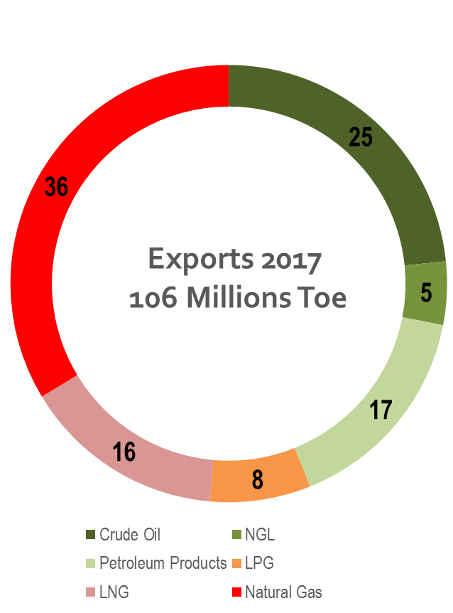
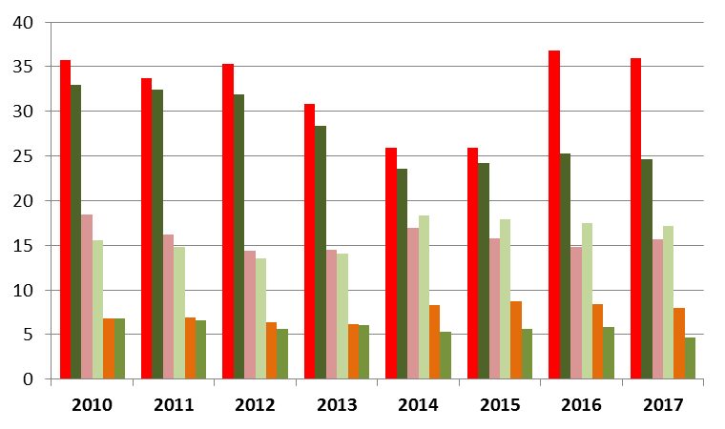
SONATRACH, Hydrocarbons Global Supplier
MToe

Slide 13
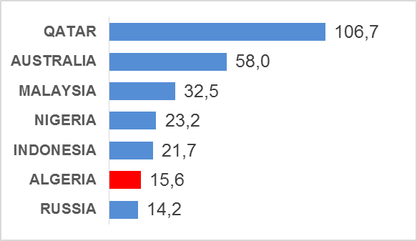
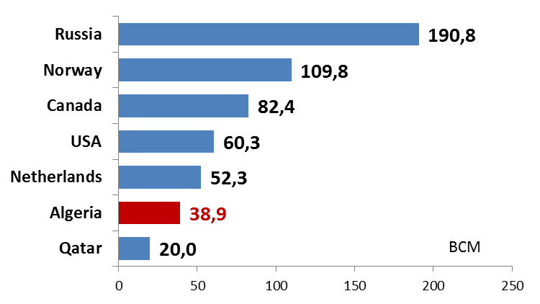
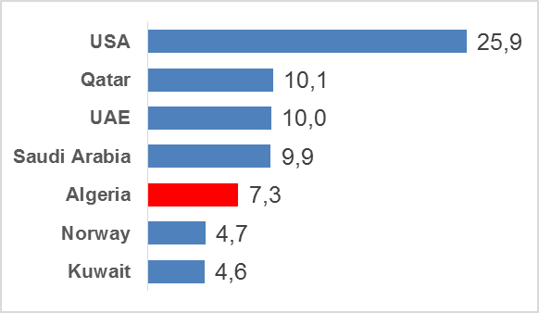
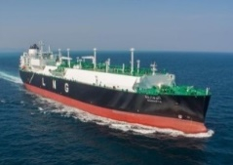
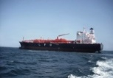
SONATRACH, Gas & LPG Player in the world
World LNG Exports 2016
World Natural Gas Exports 2016
World LPG Exports 2016
BCM
6th
World LNG Supplier
4%
of World LNG Imports
6th
World
Natural Gas
Supplier
5%
of World NG Imports
5th
World LPG
Supplier
10%
of World LPG Imports
8 LNG carriers
1 MCM
9 LPG carriers
460 kCM
Source: BP Statistical review, 2017; SONATRACH figures 2016.

Slide 14
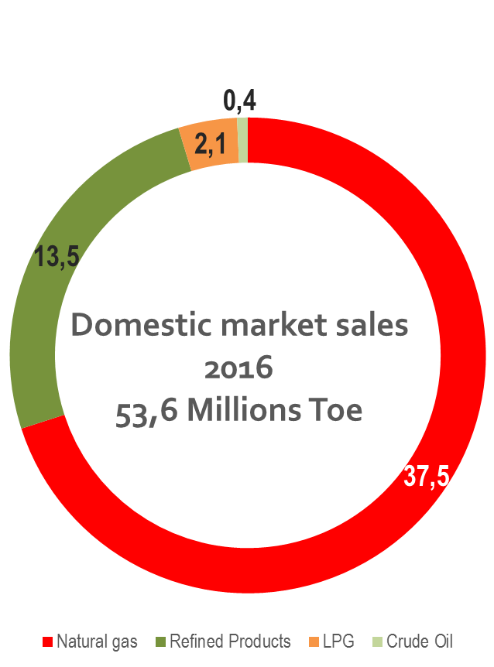
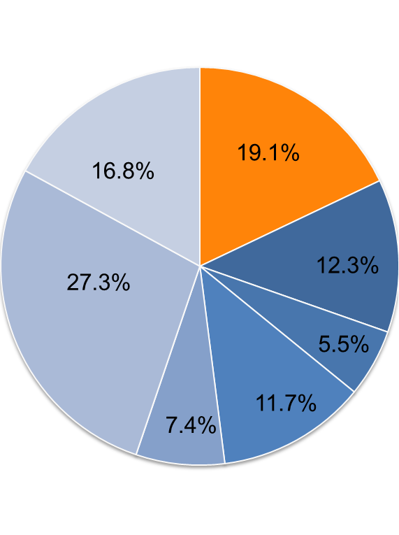
SONATRACH, Major rôle in the Algerian Energy market & Economy
Domestic market sales 2017:
54,3 MToe
Hydrocarbons Industry Contribution to the national economy in 2017
Administrative
services
Hydrocarbons
Agriculture
Industry
Services
Construction
Taxes
Source : ONS, 2017

Slide 15
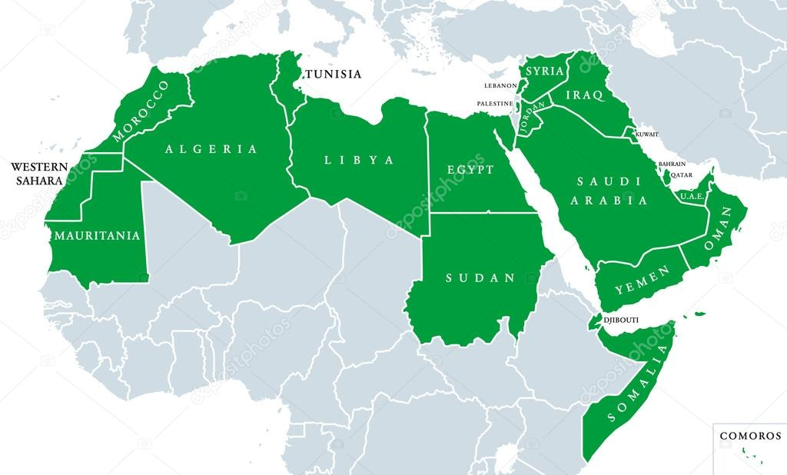










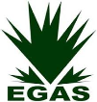

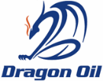




SONATRACH, E&P Cooperation with Arab countries

Slide 16


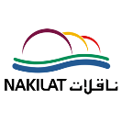



SONATRACH, Hydrocarbons Transport Cooperation with Arab countries

Slide 17












SONATRACH, Downstream Cooperation with Arab countries

Slide 18








SONATRACH, Commercial Cooperation with Arab countries

Slide 19




SONATRACH, E&P Cooperation with China
Operating Projet
China Petroleum and Chemical Corporation
Enhancing recovery rate of crude oil reserves in place of the Zarzaitine deposit Contract

Slide 20


SONATRACH, E&P Cooperation with China
China National Petroleum Corporation
Research, Appraisal and development of El M'Zaid Hydrocarbons Field,
Project in development phase.
Ongoing Projet

Slide 21

SONATRACH, E&P Cooperation with China
China National Offshore Oil Corporation
Research, Appraisal and development of El Hassi Bir Rekaiz Hydrocarbons Field,
Ongoing Projet

Slide 22

SONATRACH, Hydrocarbons Transport Cooperation with China
China Petroleum Engineering & Construction Corporation
SP1/Hassi Messaoud pumping station EPC, adjoining the oil pipeline (HEH – Béjaia)
Ongoing Projet

Slide 23
SONATRACH, Downstream – Refining Cooperation with China
Ongoing Projet
Algiers Refinery (RA1G) Rehabilitation Project
Operating Projet
05 million tons per year condensate refinery EPC: operating since 2009 & located in Skikda
Increase of Naphta & Butane Storage Capacity + Fuel Oil and Naphtha Shipping Capacity (RA1K)
China National PetroleumCorporation
Operating Projet
0,6 Million tons par year crude oil refinery in Adrar : operating since may 2007. CNPC as EPC & Partner.

Slide 24

SONATRACH, Hydrocarbons Exports to China... faraway so close
KToe

Slide 25
Conclusions
Algeria still has a large unexplored and undiscovered potential for hydrocarbons, which could contribute to the long-term energy security of the country and other parts of the world.
To create more attractive framework and facilitate access to partners, an amendment to the hydrocarbons law is in progress and will be published in early 2019.
Sonatrach, as a historical energy supplier with a large presence in the hydrocarbons value chain, with a solid expertise & know-how, is looking ahead for more future fruitful partnerships.

